Slide 1
UNIT - 5
Searching and Sorting

Slide 2
Searching
Searching means to find whether a particular value is present in an array or not.
If the value is present in the array, then searching is said to be successful and the searching process gives the location of that value in the array.
However, if the value is not present in the array, the searching process displays an appropriate message and in this case searching is said to be unsuccessful.

Slide 3
Searching
There are two popular methods for searching the array elements: linear search and binary search.

Slide 4
Linear Search
Linear search, also called as sequential search, is a very simple method used for searching an array for a particular value.
It works by comparing the value to be searched with every element of the array one by one in a sequence until a match is found.
Linear search is mostly used to search an unordered list of elements (array in which data elements are not sorted). For example, if an array
A[] is declared and initialized as,
int A[] = {10, 8, 2, 7, 3, 4, 9, 1, 6, 5};

Slide 5
Linear Search
the value to be searched is VAL = 7, then searching means to find whether the value ‘7’ is present in the array or not.
If yes, then it returns the position of its occurrence. Here,
POS = 3 (index starting from 0).

Slide 6
Linear Search
#include<stdio.h>
#include<conio.h>
void main()
{
int a[20],i,x,n;
clrscr();
printf("How many elements?");
scanf("%d",&n);
printf("Enter array elements:\n");
for(i=0;i<n;++i)
{
scanf("%d",&a[i]);
}
printf("\nEnter element to search:");
scanf("%d",&x);

Slide 7
Linear Search
for(i=0;i<n;++i)
{
if(a[i]==x)
break;
}
if(i<n)
printf("Element found at index %d",i);
else
printf("Element not found");
getch();
}

Slide 8
Binary Search
Search a sorted array by repeatedly dividing the search interval in half is called Binary Search.
Binary search is a searching algorithm that works efficiently with a sorted list. The mechanism of binary search can be better understood by an analogy of a telephone directory.
When we are searching for a particular name in a directory, we first open the directory from the middle and then decide whether to look for the name in the first part of the directory or in the second part of the directory.
Again, we open some page in the middle and the whole process is repeated until we finally find the right name

Slide 9
Binary Search
Now, let us consider how this mechanism is applied to search for a value in a sorted array.
Consider an array A[] that is declared and initialized as int A[] = {0, 1, 2, 3, 4, 5, 6, 7, 8, 9, 10};
and the value to be searched is VAL = 9. The algorithm will proceed in the following manner.
BEG = 0, END = 10, MID = (0 + 10)/2 = 5
Now, VAL = 9 and A[MID] = A[5] = 5
A[5] is less than VAL, therefore, we now search for the value in the second half of the array. So, we change the values of BEG and MID.

Slide 10
Binary Search
Now, BEG = MID + 1 = 6, END = 10, MID = (6 + 10)/2 =16/2 = 8
VAL = 9 and A[MID] = A[8] = 8
A[8] is less than VAL, therefore, we now search for the value in the second half of the segment.
So, again we change the values of BEG and MID.
Now, BEG = MID + 1 = 9, END = 10, MID = (9 + 10)/2 = 9
Now, VAL = 9 and A[MID] = 9.

Slide 11
Binary Search
#include<stdio.h>
#include<conio.h>
void main()
{
int c, first, last, middle, n, search, array[100];
printf("Enter number of elements\n");
scanf("%d", &n);
printf("Enter %d integers\n", n);
for (c = 0; c < n; c++)
scanf("%d", &array[c]);
printf("Enter value to find\n");
scanf("%d", &search);
first = 0;
last = n - 1;
middle = (first+last)/2;

Slide 12
Binary Search
while (first <= last)
{
if (array[middle] < search)
{
first = middle + 1;
}
else if (array[middle] == search)
{
printf("%d found at location %d.\n", search, middle+1);
break;
}
else
{
last = middle - 1;
}
middle = (first + last)/2;
}
if (first > last)
printf("Not found! %d isn't present in the list.\n", search);
getch();
}

Slide 13
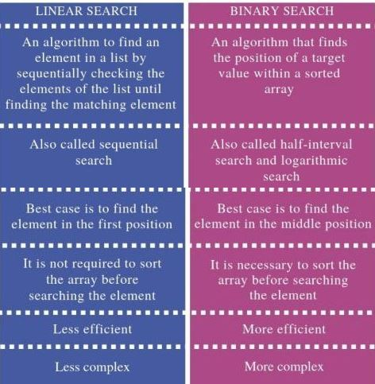
Difference Between Linear Search and Binary Search

Slide 14
SORTING
Sorting means arranging the elements of an array so that they are placed in some relevant order which may be either ascending or descending.
For example, if we have an array that is declared and initialized as
int A[] = {21, 34, 11, 9, 1, 0, 22};
Then the sorted array (ascending order) can be given as:
A[] = {0, 1, 9, 11, 21, 22, 34};

Slide 15
BUBBLE SORT
Bubble sort is a very simple method that sorts the array elements by repeatedly moving the largest element to the highest index position of the array segment (in case of arranging elements in ascending order).
In bubble sorting, consecutive adjacent pairs of elements in the array are compared with each other. If the element at the lower index is greater than the element at the higher index, the two elements are interchanged so that the element is placed before the bigger one.
This process will continue till the list of unsorted elements exhausts.

Slide 16
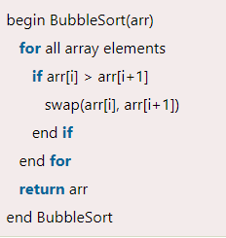
BUBBLE SORT
Algorithm

Slide 17
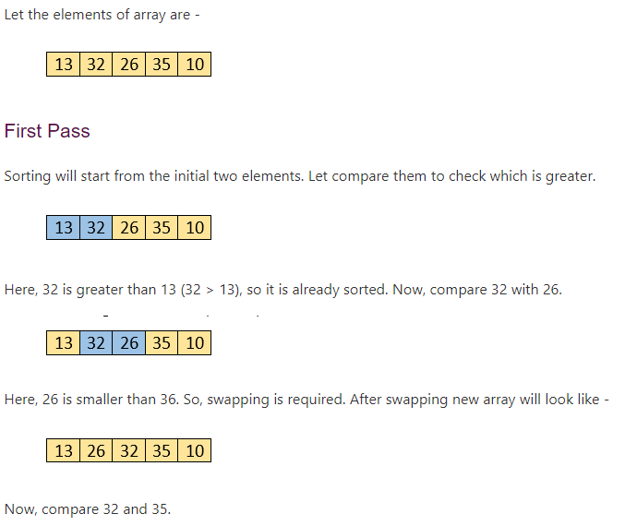
BUBBLE SORT

Slide 18
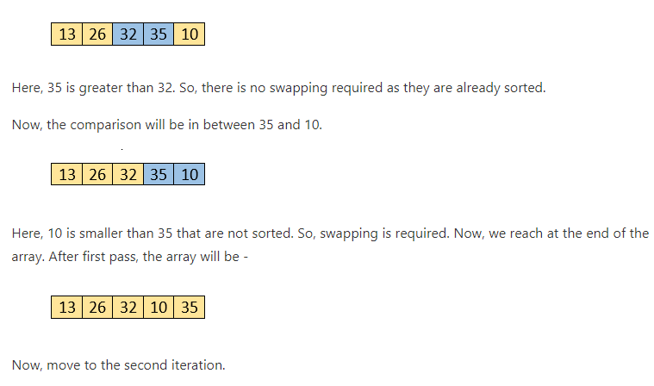
BUBBLE SORT

Slide 19

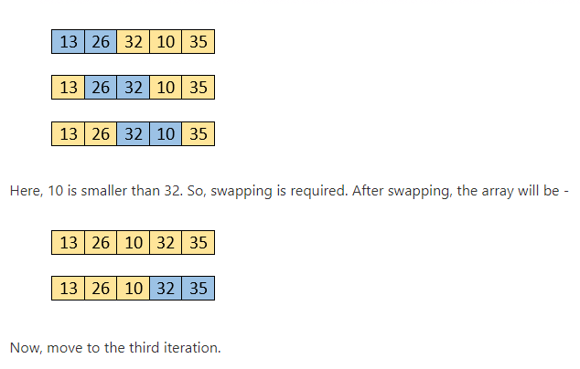
BUBBLE SORT

Slide 20

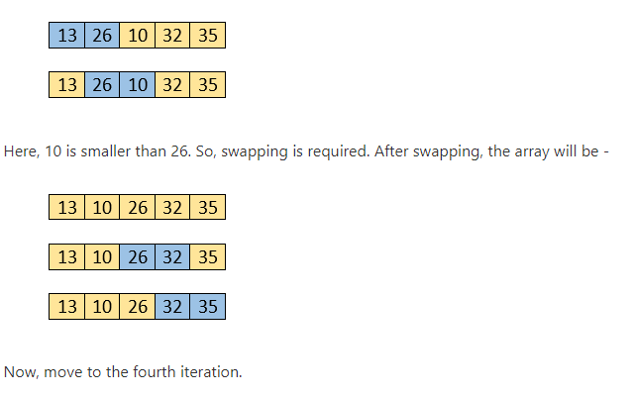
BUBBLE SORT

Slide 21
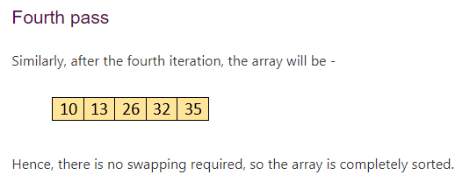
BUBBLE SORT

Slide 22
BUBBLE SORT
#include<stdio.h>
#include<conio.h>
void main()
{
int array[100], n,i,j, swap;
clrscr();
printf("Enter number of elements\n");
scanf("%d", &n);
printf("Enter %d integers\n", n);
for (i = 0; i < n; i++)
{
scanf("%d", &array[i]);
}

Slide 23
BUBBLE SORT
for (i = 0 ; i < n - 1; i++)
{
for (j = 0 ; j < n - i - 1; j++)
{
if (array[j] > array[j+1])
{
swap = array[j];
array[j] = array[j+1];
array[j+1] = swap;
}
}
}
printf("Sorted list in ascending order:\n");
for (i = 0; i < n; i++)
printf("%d\n", array[i]);
getch();
}

Slide 24
INSERTION SORT
Insertion Sort in C is a simple and efficient sorting algorithm, that creates the final sorted array one element at a time.
The main idea behind insertion sort is that it inserts each item into its proper place in the final list. To save memory, most implementations of the insertion sort algorithm work by moving the current data element past the already sorted values and repeatedly interchanging it with the preceding value until it is in its correct place. If the given input array is sorted or nearly sorted, then it gives best performance.

Slide 25
INSERTION SORT
Insertion sort works similar to the sorting of playing cards in hands. It is assumed that the first card is already sorted in the card game, and then we select an unsorted card. If the selected unsorted card is greater than the first card, it will be placed at the right side; otherwise, it will be placed at the left side. Similarly, all unsorted cards are taken and put in their exact place.

Slide 26
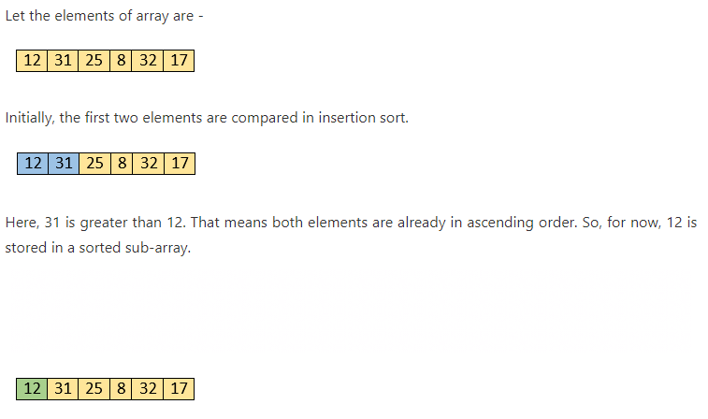
INSERTION SORT

Slide 27
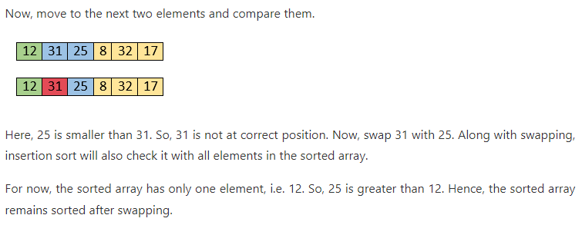
INSERTION SORT

Slide 28
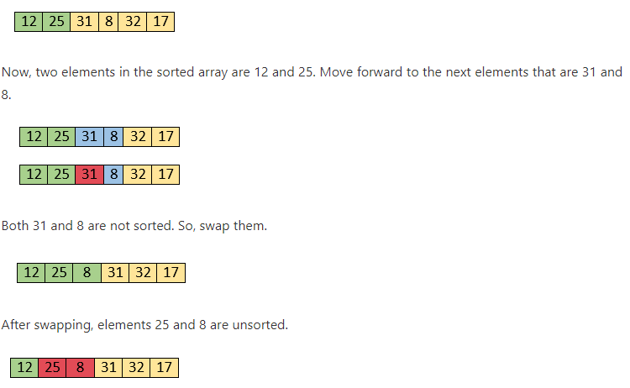
INSERTION SORT

Slide 29
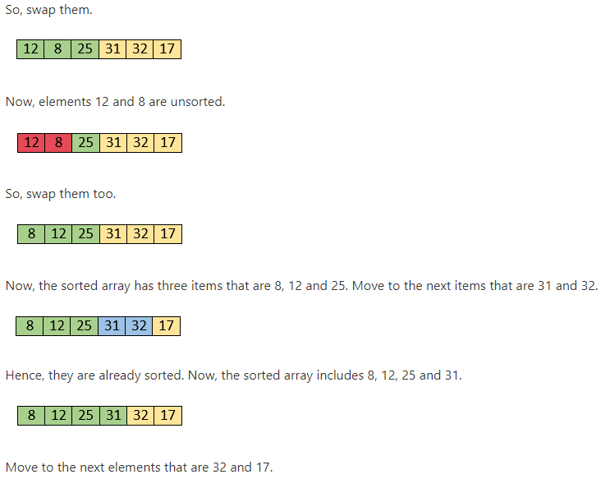
INSERTION SORT

Slide 30
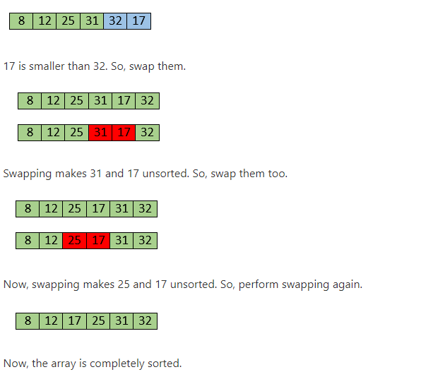
INSERTION SORT

Slide 31
INSERTION SORT
#include<stdio.h>
#include<conio.h>
void main()
{
int n, array[100], c, d, t, flag = 0;
clrscr();
printf("Enter number of elements\n");
scanf("%d", &n);
printf("Enter %d integers\n", n);
for (c = 0; c < n; c++)
scanf("%d", &array[c]);
for (c = 1 ; c <= n - 1; c++)
{
t = array[c];
for (d = c - 1 ; d >= 0; d--)
{

Slide 32
INSERTION SORT
if (array[d] > t)
{
array[d+1] = array[d];
flag = 1;
}
else
break;
}
if (flag)
array[d+1] = t;
}
printf("Sorted list in ascending order:\n");
for (c = 0; c <= n - 1; c++)
{
printf("%d\n", array[c]);
}
getch();
}

Slide 33
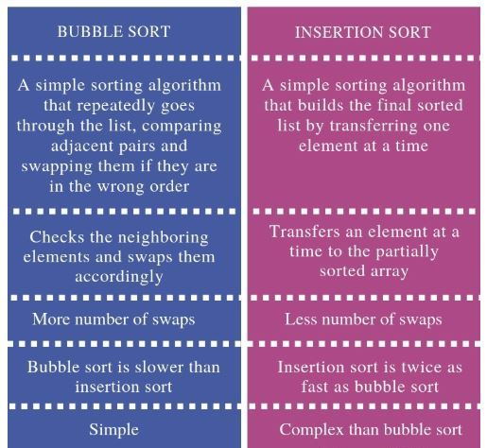
Differentiate Bubble Sort and Insertion Sort

Slide 34
SELECTION SORT
Selection Sort algorithm is an in-place comparison-based algorithm in which the list is divided into two parts, the sorted part at the left end and the unsorted part at the right end.
Although selection sort performs worse than insertion sort algorithm, it is noted for its simplicity and also has performance advantages over more complicated algorithms in certain situations. Selection sort is generally used for sorting files with very large objects (records) and small keys.

Slide 35
SELECTION SORT
Selection sort works as follows:
First find the smallest value in the array and place it in the first position. Then, find the second smallest value in the array and place it in the second position. Repeat this procedure until the entire array is sorted.
Selection sort is not a stable sorting algorithm.
Consider the situation in which assignment operation is very costly. so that the number of assignment operations is minimized in general.

Slide 36
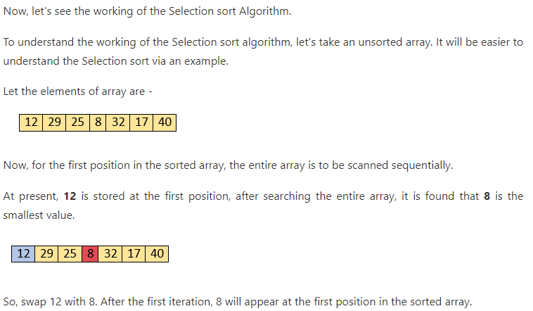
SELECTION SORT

Slide 37
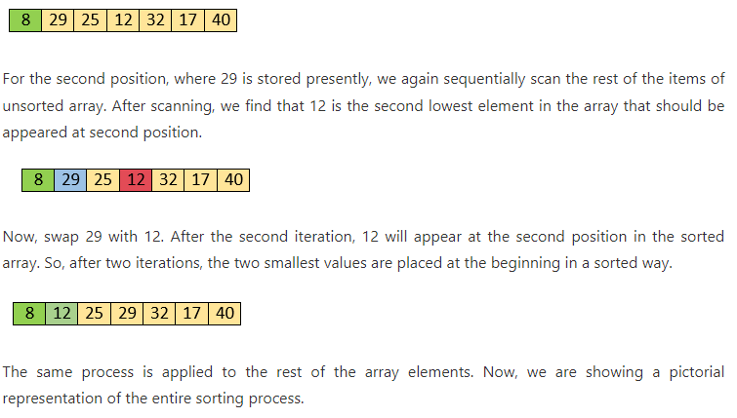
SELECTION SORT

Slide 38
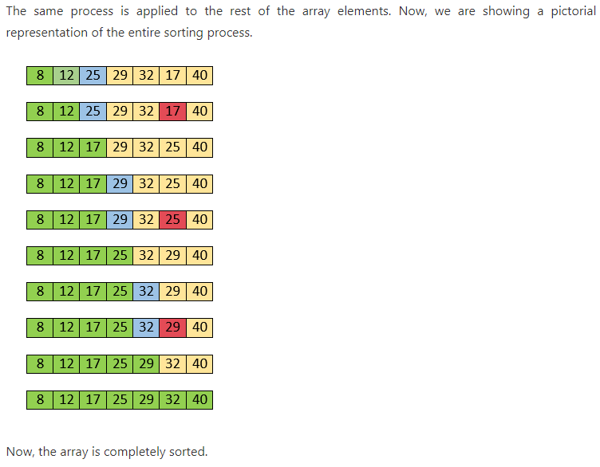
SELECTION SORT

Slide 39
SELECTION SORT
#include <stdio.h>
#include <conio.h>
void main()
{
int a[100], n, i, j, position, swap;
clrscr();
printf("Enter number of elements\n");
scanf("%d", &n);
printf("Enter %d Numbers\n", n);
for (i = 0; i < n; i++)
{
scanf("%d", &a[i]);
}
for(i = 0; i < n - 1; i++)
{
position=i;
for(j = i + 1; j < n; j++)
{
if(a[position] > a[j])
position=j;
}
if(position != i)
{
swap=a[i];
a[i]=a[position];
a[position]=swap;
}
}

Slide 40
SELECTION SORT
printf("Sorted Array:\n");
for(i = 0; i < n; i++)
{
printf("%d\n", a[i]);
}
getch();
}

Slide 41
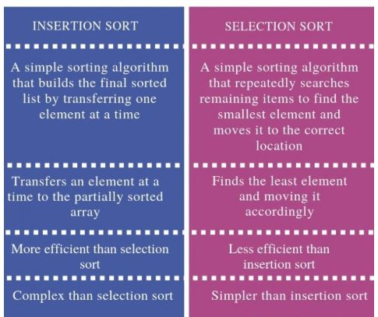
DIFFERENTIATE INSERTION AND SELECTION SORT

Slide 42
QUICK SORT
Quicksort is a divide and conquer algorithm.
The steps are: 1) Pick an element from the array, this element is called as pivot element. 2) Divide the unsorted array of elements in two arrays with values less than the pivot come in the first sub array, while all elements with values greater than the pivot come in the second sub-array (equal values can go either way). This step is called the partition operation. 3) Recursively repeat the step 2(until the sub-arrays are sorted) to the sub-array of elements with smaller values and separately to the sub-array of elements with greater values.
The same logic we have implemented in the following C program.

Slide 43
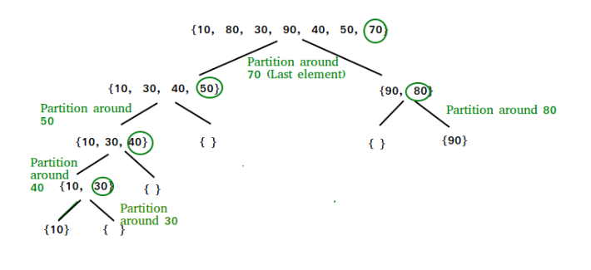
QUICK SORT

Slide 44
QUICK SORT
#include<stdio.h>
#include<conio.h>
void quicksort(int number[25],int first,int last)
{
int i, j, pivot, temp;
if(first<last)
{
pivot=last;
i=first;
j=last;
while(i<j)
{
while(number[i]<=number[pivot]&&i<last)
i++;
while(number[j]>number[pivot])
j--;
if(i<j)
{
temp=number[i];
number[i]=number[j];
number[j]=temp;
}
}

Slide 45
QUICK SORT
temp=number[pivot];
number[pivot]=number[j];
number[j]=temp;
quicksort(number,first,j-1);
quicksort(number,j+1,last);
}
}
void main()
{
int i, count, number[25];
clrscr();
printf("How many elements are u going to enter?: ");
scanf("%d",&count);
printf("Enter %d elements: ", count);
for(i=0;i<count;i++)
scanf("%d",&number[i]);
quicksort(number,0,count-1);
printf("Order of Sorted elements: ");
for(i=0;i<count;i++)
printf(" %d",number[i]);
getch();
}

Slide 46
HEAP SORT
Heap sort is a comparison based sorting technique based on Binary Heap data structure.
It is similar to selection sort where we first find the maximum element and place the maximum element at the end. We repeat the same process for remaining element.

Slide 47
HEAP SORT
Now, let's see the working of the Heapsort Algorithm.
In heap sort, basically, there are two phases involved in the sorting of elements. By using the heap sort algorithm, they are as follows –
The first step includes the creation of a heap by adjusting the elements of the array.
After the creation of heap, now remove the root element of the heap repeatedly by shifting it to the end of the array, and then store the heap structure with the remaining elements.

Slide 48
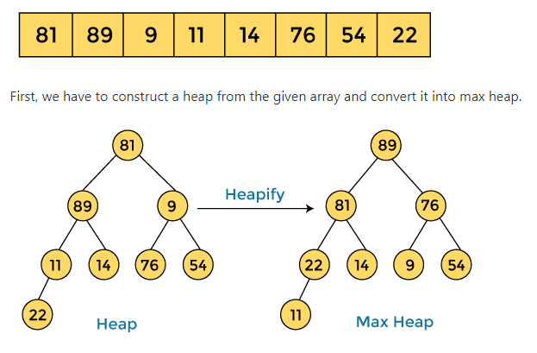
HEAP SORT

Slide 49
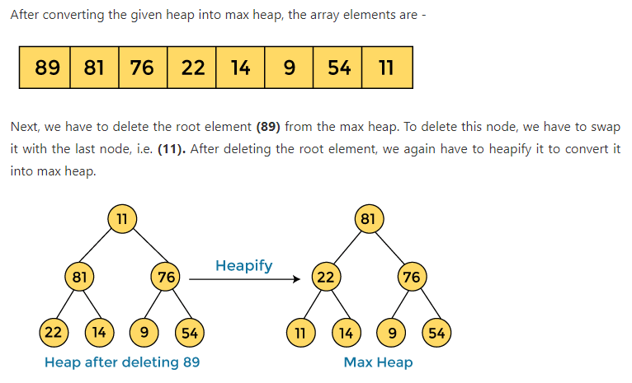
HEAP SORT

Slide 50
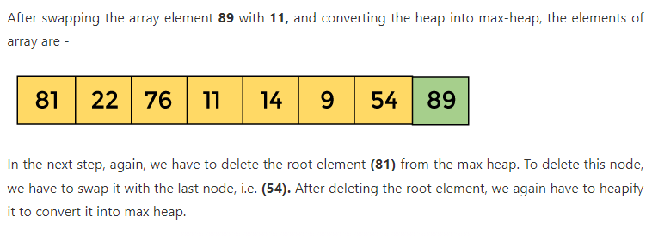
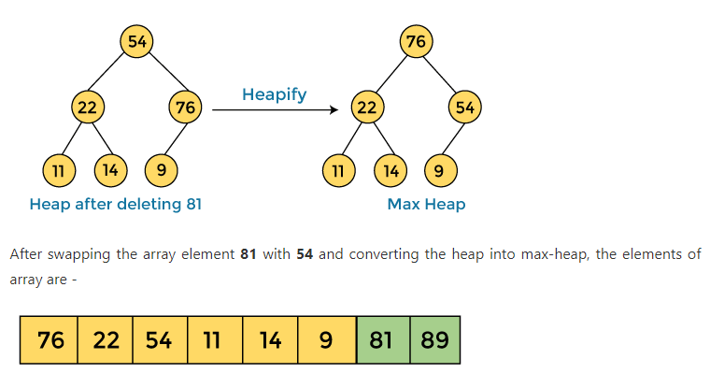
HEAP SORT

Slide 51
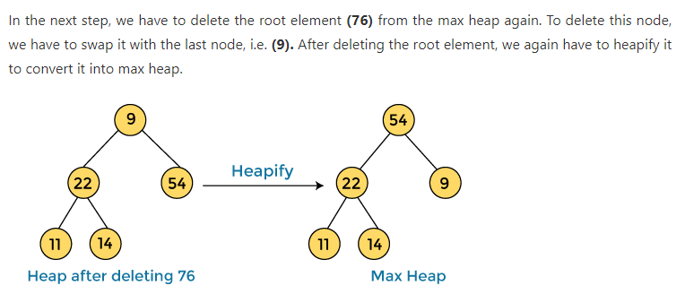
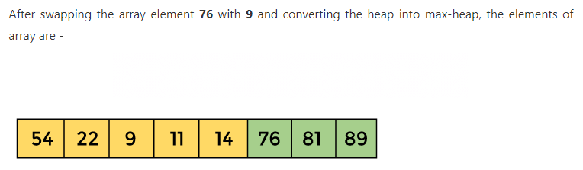
HEAP SORT

Slide 52
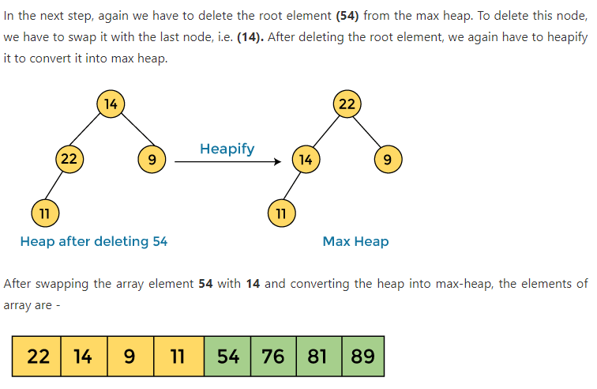
HEAP SORT

Slide 53
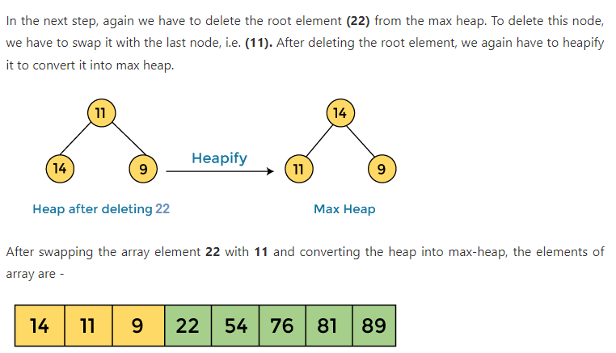
HEAP SORT

Slide 54
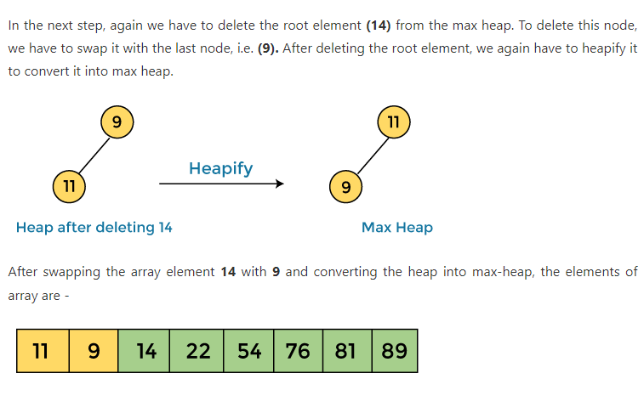
HEAP SORT

Slide 55
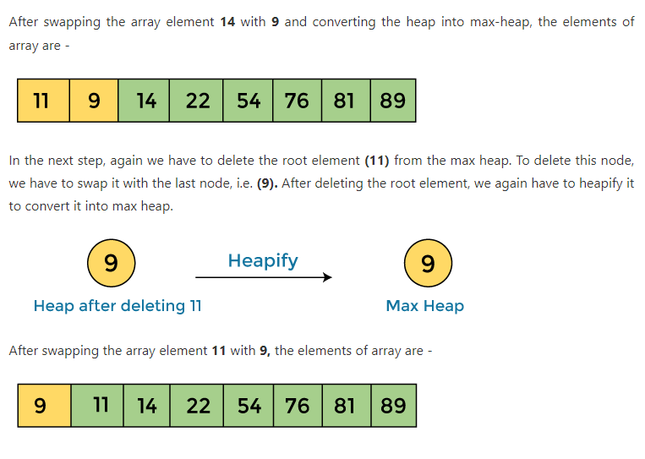
HEAP SORT

Slide 56
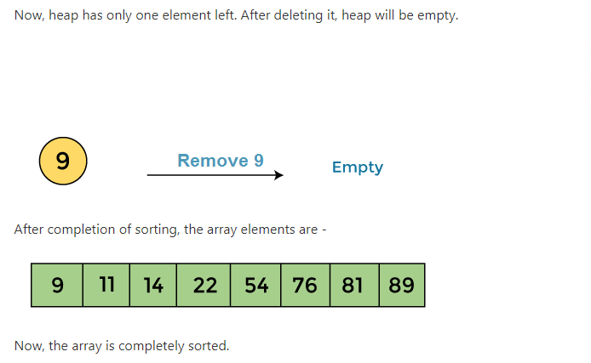
HEAP SORT

Slide 57
MERGE SORT
Merge Sort is a Divide and Conquer algorithm. It divides input array in two halves, calls itself for the two halves and then merges the two sorted halves.
It is very efficient sorting algorithm with near optimal number of comparison. Recursive Algorithm used for merge sort comes under the category of divide and conquer technique. It is stable sorting algorithm.
You can sort lots of amount of data using small available main memory using merge sort.
An array of n elements is split around its center producing two smaller arrays. After these two arrays are sorted independently, they can be merged to produce the final sorted array.

Slide 58

MERGE SORT
Working of Merge sort Algorithm
Now, let's see the working of merge sort Algorithm.
To understand the working of the merge sort algorithm, let's take an unsorted array. It will be easier to understand the merge sort via an example.
Let the elements of array are –
According to the merge sort, first divide the given array into two equal halves. Merge sort keeps dividing the list into equal parts until it cannot be further divided.
As there are eight elements in the given array, so it is divided into two arrays of size 4.

Slide 59
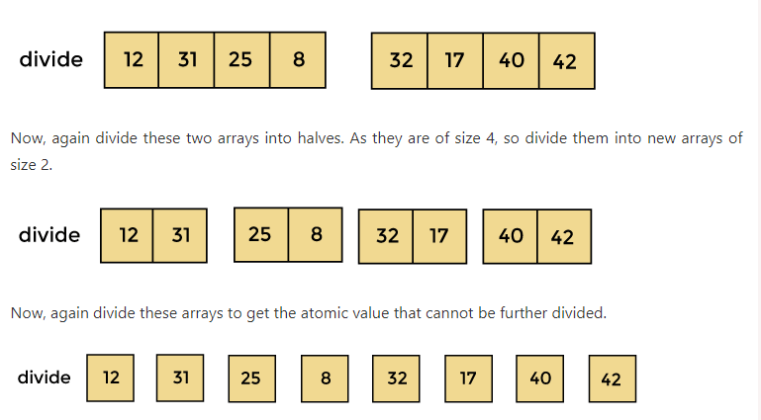
MERGE SORT

Slide 60
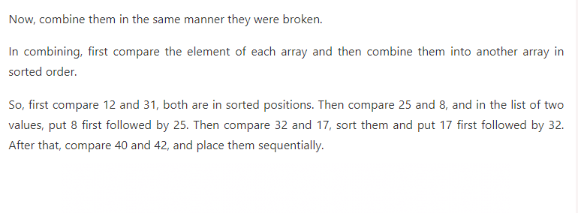
MERGE SORT

Slide 61
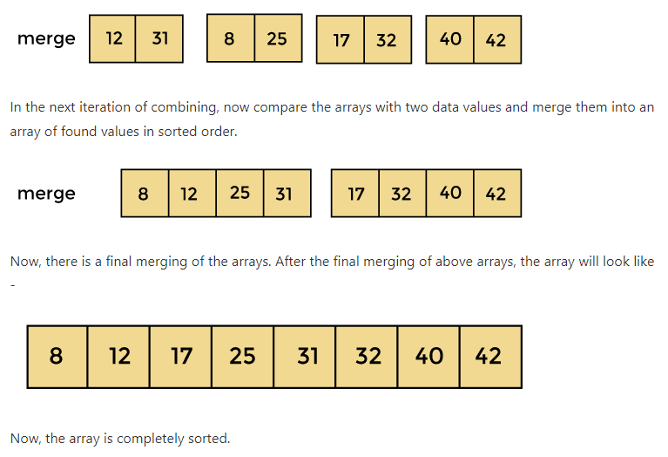
MERGE SORT

Slide 62
THANK YOU

